Slide 1
Annual Report: July 1, 2018 to June 30, 2019

Slide 2
Between July 1, 2018 and June 30, 2019, we said hello to…

Slide 3
Casey Kraichoke

Slide 4
Emily Graham

Slide 5
Guymon Hall

Slide 6
Aaron Abbott

Slide 7
Erich Washausen

Slide 8
Leigh Marshall

Slide 9
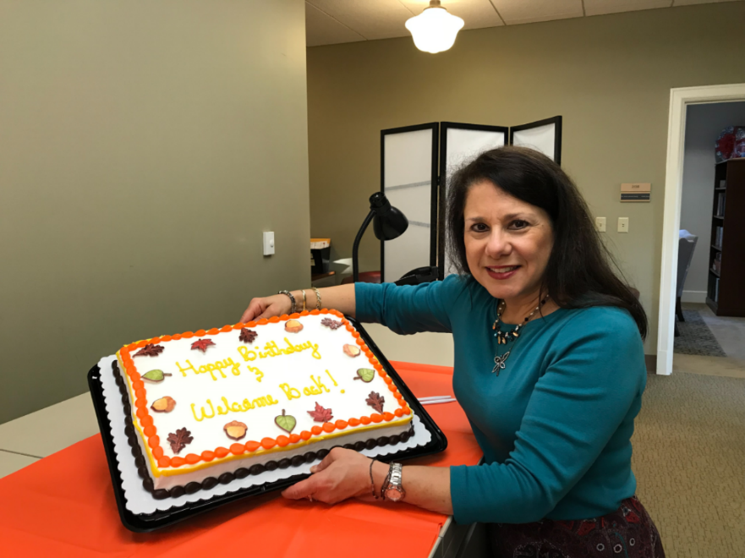
Dean Needy
From January 2018 to October 2018, we shared Dean Needy with the Office of Research and Innovation where she was interim director. We got her back full-time October 1st.

Slide 10
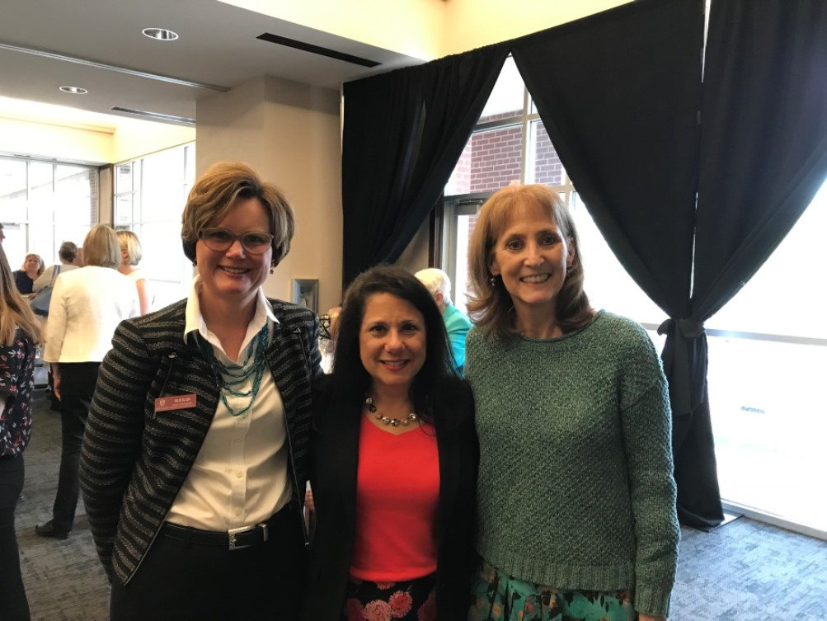
We said good-bye to DeDe Long
DeDe Long, long-time director of the Office of Study Abroad and International Education, retired from the University.
Sarah Malloy was named the new director.

Slide 11
We also said good-bye to
Brittany D. Smith
Amy Smith
Suzie Greer
Susan Byram
Amanda Cantu
Kathy White
Romona West

Slide 12
Vision
The Graduate School and International Education assists the University of Arkansas in excelling at research, teaching, training, and service while fostering student and scholar success and enhancing the overall student academic experience.

Slide 13
MISSION
The Graduate School and International Education supports the strategic goals of the University of Arkansas to continue as a very high research university; recruits, retains and graduates high-caliber students; advocates for students and student success; facilitates intercultural and international experiences to increase global competencies; and assists in the development of international, inter-disciplinary, and graduate programs.

Slide 14
Annual Report
Notable Achievements and Changes – unit wide
Graduate School
International Education
Interdisciplinary Studies

Slide 15
Notable Achievements and Changes – Unit Wide
University Awards
Professional Awards
Other Awards
Grants Received
International Visibility
National Visibility
Regional Visibility
Recognitions
Outreach
Development

Slide 16
University Awards – Staff Senate
Employee of the Third Quarter – Jan/Feb/March 2019 – JoAnn Kvamme
Employee of the Fourth Quarter – April/May/June 2019 – LeAnn Suggs
Staff Scholarship Awardee – Kayla McGrew
Employees of the Year (2018-19) – JoAnn Kvamme and LeAnn Suggs

Slide 17
University Awards – Staff Senate Employees of the Year
LeAnn Suggs
JoAnn Kvamme

Slide 18
Employees of the Year

Slide 19
But just to remind everyone…
Employees of the Quarter and of the year - 2018
Amanda Cantu
Cassie Franklin

Slide 20
Collis Geren Awards - 10th Annual Celebration
Dave Dawson
Adnan Alrubaye
Cassie Franklin

Slide 21
University Awards – Hoyt Purvis Award for Service in International Education
Lanier Nalley
Leyah Bergman-Lanier
Chelsea Hodge

Slide 22
U of A GSIE Outstanding Mentor Award
Dr. Anna Zajicek, Chair of the Department of Sociology and Criminology, was selected as the GSIE Outstanding Mentor

Slide 23
Office of Nationally Competitive Awards
Sarah Malloy, Associate Director of the Office of Study Abroad and International Exchange, received the Staff Gold Medal award.

Slide 24
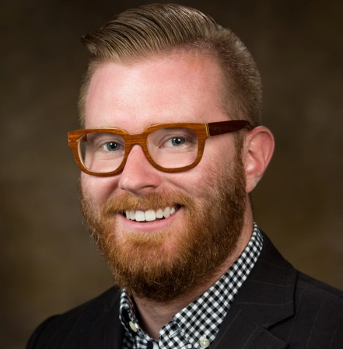
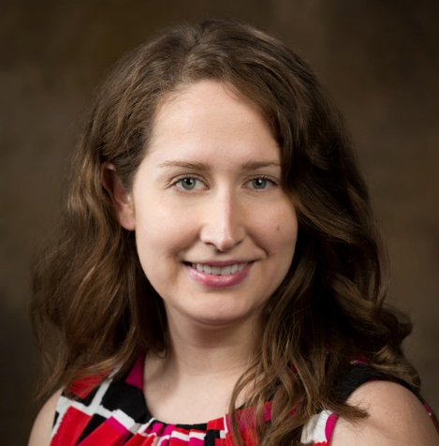
Office of Nationally Competitive Awards
Veronica Mobley, Brian Poepsel, and Katie Sabo, from the Office of Study Abroad and International Exchange, received the outstanding mentor award

Slide 25
University of Arkansas Alumni Society
Dr. Lee Lane, an alumnus of the University and member of our campaign committee, was awarded the Citation of Distinguished Alumni.

Slide 26
University of Arkansas Black Alumni Society
JoAnn Kvamme, Assistant Director of the Environmental Dynamics Ph.D. program, was awarded the Myron “Mike” Macechko Diversity Advocacy Awards.

Slide 27
Sponsored Student Programs
Susan Byram was recognized for her contributions to the success of the sponsored student programs with the SSP Staff Recognition Award.

Slide 28
Faculty awards
Dr. Doug Rhoads, Director of the Cell and Molecular Biology interdisciplinary degree programs, was inducted into the UA Teaching Academy.
Dr. Adnan Alrubaye, Associate Director of CEMB, was the recipient of the Master Teaching Award form the Fulbright College of Arts and Sciences.

Slide 29
Student Awards
Oluwatobi Olorunsola, a doctoral student in Microelectronics-Photonics, was awarded the International Optics and Photonics Education Scholarship from the Society of Photographic Instrumentation Engineers.
In 2018, Ellen Czaplinski (a doctoral student in Space and Planetary Sciences) was one of only 10 graduate students selected from an international pool of applicants for an internship with the NASA-sponsored Center for Lunar Science and Exploration. She continues to be supported as one of only approximately 30 students selected annually to receive the prestigious NASA Earth and Space Science Fellowship.
Gina Riggio, a doctoral student in Cell and Molecular Biology, won first place in the student poster competition at the Universities Council on Water Resources/National Institutes for Water Resources annual water conference in June 2019. Her project was funded through the Arkansas Water Resources Center 104B grant program and her major advisor was Dr. Kristen Gibson in Food Science.
Electa Hare-Redcorn, a student in the Public Policy Ph.D. program, was named a recipient of the Native American 40 Under 40 Award from the National Center for American Indian Enterprise Development.

Slide 30
Professional Awards
Dean Needy received three significant professional honors:
Albert G. Holzman Distinguished Educator Award and Engineering Economy Wellington Award from the Institute of Industrial and Systems Engineers.
Merl Baker Award from the American Society of Engineering Education, Engineering Management Division.

Slide 31
Professional Awards
Yassaman Mirdamadi received the Service Recognition Award for Professional Contributions to the National College Testing Association this year for the ninth consecutive year.
She was also elected to serve as the Secretary of the Governing Board of the Arkansas College Testing Association.

Slide 32
International Visibility
Leadership from the U of A Rome Center and GSIE organized and hosted 30 Years in Rome, a two-day celebration of the University’s academic presence in Rome. More than 125 dignitaries, faculty, university representatives and students attended the event.

Slide 33
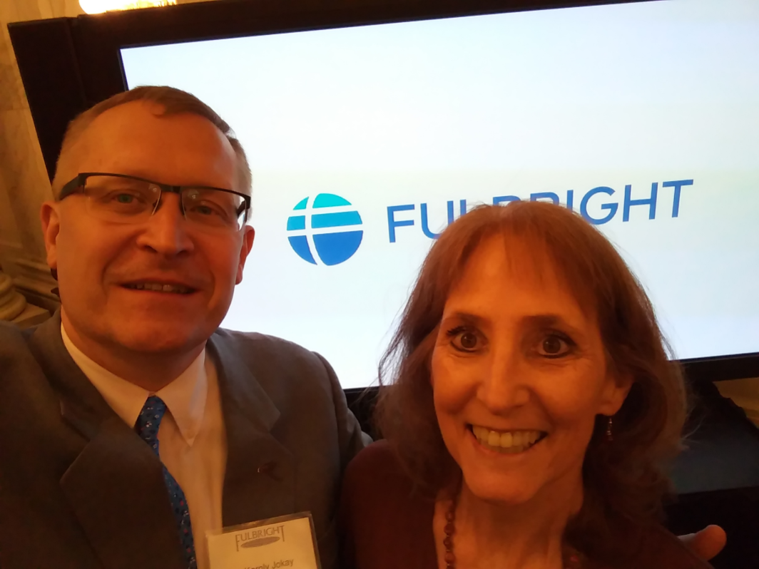
International Visibility
DeDe Long, Director of Study Abroad and International Education, chaired the conference committee for the Fulbright Association annual conference in Puebla, Mexico in November
Ms. Long represented the University at the awarding of the Fulbright Prize to Chancellor Angela Merkel in Berlin in January 2019.

Slide 34
InternationalVisibility
DeDe Long received the Life Membership Award from NAFSA: Association of International Educators

Slide 35
National Visibility
The Environmental Dynamics program supported the National Council for Science and the Environment meeting, with the Fay Jones School of Architecture and Design, June 24-26, on the UA campus.

Slide 36
National Visibility - GPSC
The Graduate and Professional Student Congress was recognized as the regional and national member of the year by the National Association of Graduate and Professional Schools – the only organization ever to win twice in a row.
GPSC hosted the meetings of the national association in Fayetteville in November 2018.

Slide 37
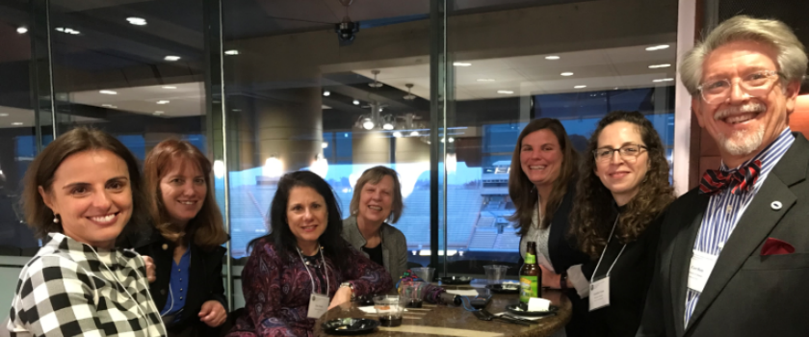
Regional Visibility
Dean Needy was selected as the chair-elect of the Conference of Southern Graduate Schools

Slide 38
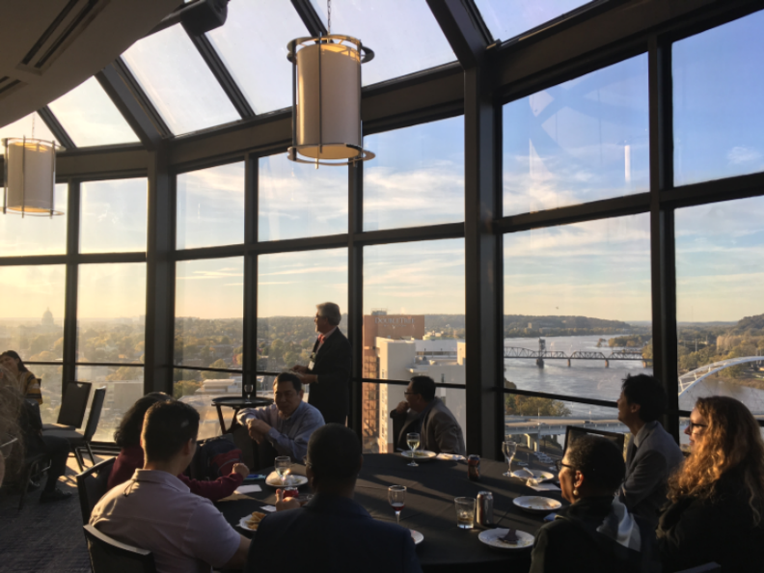
Regional Visibility -NAFSA Region III Conference
Karl Anderson served as the chair of this years’ conference
Laura Moix was the conference planner.
Dean Rom addressed the attendees at the SIO reception

Slide 39
Outreach
Because of the efforts of Julie Olsen, Vicky Hartwell and Laura Moix, five U of A graduate student were awarded the P.E.O. (Philanthropic Educational Organization) Scholar awards for the 2019-20 academic year.

Slide 40
Development
Total Campaign Arkansas fundraising for GSIE/VPRI was $2,897,147 as of June 30, 2019.
During the All in For Arkansas campaign, GSIE received 55 gifts from GSIE alumni, staff and friends totaling $6,862.

Slide 41
Development
Many members of GSIE traveled across the U.S. and the world to visit with alumni and friends.

Slide 42
Development
Michael Rau was selected as the winner of the 2018 University Advancement Winter Scene Holiday Design Contest.

Slide 43
Graduate School
The Admissions Office processed 7,458 applications (fall 2018, spring 2019, summer 2019).
4,601 domestic graduate
1,553 international graduate
1,304 international undergraduate

Slide 44
Graduate School
Fall 2018 graduate enrollment was 4,024, a 3.29% decrease from the previous year. As a percentage of the total University enrollment, graduate student enrollment decreased from 15.10% in Fall 2017 to 14.49% in Fall 2018, becoming the third lowest in the SEC after Alabama and the University of Mississippi.
Graduate enrollment of under-represented minorities was 19.8% of total domestic graduate enrollment in Fall 2018 compared to 18.3% in Fall 2017; enrollment of under-represented minorities in doctoral programs increased from 169 in Fall 2017 to 174 in Fall 2018.

Slide 45
Graduate School
In the most recent graduation year (2017-18), we awarded master’s degrees to 1,114 students (78 fewer than the year before) and doctoral degrees to 204 students (36 more than in the previous graduation year).
Graduate School staff completed more than 1,500 thesis/dissertation pre-checks and processed 460 submissions. As the result of a resignation, Julie Rogers single-handedly processed all thesis/dissertation submissions for spring 2019. She was more than happy to welcome Leigh Marshall as the new graduation specialist.

Slide 46
Graduate School
The Office of Testing Services tested approximately 30,000 students, prospective students, and other clients in 2018 and received a positive rating of 99% on the Test Taker Satisfaction Survey.
Testing Services partnered with two vendors this year to offer additional tests such as the Health Sciences Reasoning Test and two tests for the Society of Human Resources Management.
The Slate Customer Relations Management module went live on July 1, 2018

Slide 47
Graduate School
We launched the Razorgrad Institute for Success and Engagement (RISE) with 15 students.

Slide 48
Graduate School
In Fall 2018, there were 108 Distinguished Doctoral Fellows, 204 Doctoral Academy Fellows, 46 Benjamin Franklin Lever Tuition Fellows, 52 Master of Fine Arts Graduate Fellows and six Southern Regional Education Board (SREB) Doctoral Scholars.

Slide 49
Graduate School
We hosted the Distinguished Doctoral Fellows and Doctoral Academy Fellows, plus guests and faculty members at the annual Doctoral Fellows reception in February.

Slide 50
Graduate School
We hosted our 10th Graduate Research Opportunities Forum, in March 2019. Faculty from the following institutions attended: North Carolina A & T University, University of Arkansas at Pine Bluff, Philander Smith College, University of Maryland Eastern Shore, Florida Agricultural & Mechanical University, California State University, University of Providence, Fort Valley State University, Grambling State University, St. Mary’s College of Maryland, and Claflin University.

Slide 51
Graduate School
The Graduate Recruitment Assistance Fund continued to be an important resource for departments and programs with over $47,000 being disbursed for recruitment-related travel by 22 units; 25 faculty/staff took advantage of our Best Practices in Graduate Education training sessions.

Slide 52
Graduate School
The Attracting Intelligent Minds (AIM) conference was held in September 2018. AIM is a diversity recruitment initiative that is sponsored by the Black Graduate Students’ Association (BGSA) and the Graduate School and International Education (GSIE), with support from select faculty, staff and administrators. Sixteen outstanding students from HBCUs were selected to participate.

Slide 53
International Education
National events influenced the work of the International Students and Scholars office again this year. As was the national trend, the University of Arkansas experienced a decrease in the number of enrolled international students, but the University saw an increase in the number of scholars conducting research and teaching on the campus.

Slide 54
International Education
In Fall 2018, international students comprised 5.2% of the University’s on-schedule enrollment; international graduate students accounted for 17.8% of the total on-schedule graduate population.
The enrollment of international graduate students decreased from Fall 2017 to Fall 2018 by nine students.
The population of international undergraduate students decreased by 16 students between Fall 2017 and Fall 2018, continuing a downward trend.

Slide 55
International Education
A total of 93 students actively participated in the International Culture Team (ICT) presenting their culture in at least two events.
An additional 128 students/ scholars/ spouses presented at least in one event totaling 221 presenters for the year.
These students represented 60 different countries. We had representation of two countries which had never been on the team before, Comoros and Laos.

Slide 56
International Education
The University of Arkansas welcomed the eighth cohort of 28 PAPSS scholars (from Panama) to campus in August 2018. The total number of scholars enrolled at the U of A in Fall 2018 was 129. The Fall 2018 cumulative GPA for the PAPPS scholars was 3.241.
In Fall 2018, there were 181 sponsored students from 25 sponsoring organizations and 38 countries.
We presented five students the Peace Corps Prep Certificate.
140 students were enrolled in reciprocal exchange programs in 2018-19

Slide 57
International Education
The U of A implemented the SABIC Foundation Year Program, requiring intensive collaboration between Custom and Short-term Programs in ISS, Spring International Language Center, Sponsored Student Programs and the College of Engineering; the first cohort was composed of ten Saudi Arabian students and all of them were admitted to U.S. undergraduate degree programs by Spring 2019, five of them in engineering programs at the U of A.

Slide 58
International Education
The Office of Sponsored Students Programs held the annual Welcome Reception with the Chancellor in September for new and continuing SSP students along with their faculty advisors and international educators, and also hosted the SSP Recognition Program for graduates and visiting students in both fall 2018 and spring 2019.

Slide 59
International Education
92 international students and scholars were matched to 78 Friendship Families and individuals from the NW Arkansas region for friendships in the Friendship Family Program; results from the May 2019 survey of hosts and students indicates that over 74% of matches met monthly or more after being matched in 2018-2019.

Slide 60
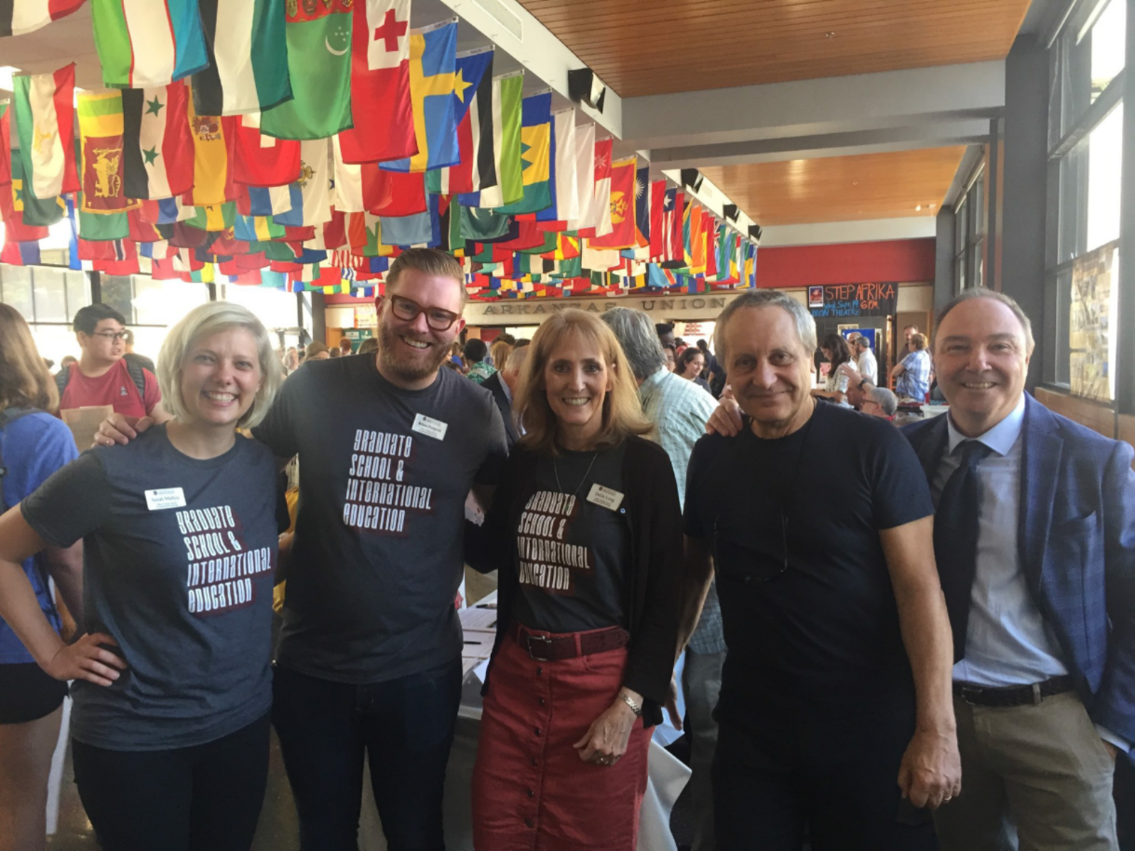
Rome Center
185 UA students studied at the Rome Center in 2018-19.

Slide 61
Rome Center
Rome Center faculty visited with faculty and staff on the U of A campus.

Slide 62
Interdisciplinary Programs
Cell and Molecular Biology, M.S., Ph.D.
Environmental Dynamics, Ph.D.
Microelectronics-Photonics, M.S., Ph.D.
Public Policy, Ph.D.
Space and Planetary Sciences, M.S., Ph.D.
Statistics and Analytics, M.S.
CEMB: Doug Rhoads, Adnan Alrubaye
ENDY: Peter Ungar, JoAnn Kvamme
MEPH: Rick Wise, Renee Hearon
PUBP: Brinck Kerr, Valerie Hunt
SPAC: Larry Roe
STAN: Mark Arnold
Program Support: Julie Brogan, Emily Graham, and Terri Fisher

Slide 63
Interdisciplinary Programs
Fall 2018 enrollment in interdisciplinary graduate programs was 269, a 1.1% increase over Fall 2017.
In the 2017-18 graduation year, the Graduate School awarded 25 interdisciplinary master’s degrees and 33 interdisciplinary doctoral degrees; accounting for 2.2% of the University’s master’s degrees and 16.2% of the University’s doctoral degrees.

Slide 64
Interdisciplinary Programs
The Public Policy program regained its position as the most diverse doctoral program on campus in Fall 2018 enrollments, with 34.8% racial/ethnic diversity (out of total enrollment) or 39.5% out of domestic enrollment.
In Fall 2018, the Microelectronics-Photonics and Cell and Molecular Biology Ph.D. programs were ranked third and fifth, respectively, in the percentage of international students in doctoral programs; the percentages were 68.6% for MEPH and 65.4% for CEMB.

Slide 65
Interdisciplinary Programs
Cell and Molecular Biology students and faculty generated slightly over $28M in continuing grant support, nearly $9M in new grant support, 34 peer-reviewed publications, 75 invited lectures/presentations/seminars and one patent. In addition, nine students won 15 awards.
Environmental Dynamics students were awarded over $1M in external and internal grants in 2018-19 with $61,567 in external awards; were co-authors on nine refereed publications and one book chapter; gave six invited lectures, eleven oral presentations and eight poster presentations.
Microelectronics–photonics students authored/co-authored 61 papers/presentations and had six provisional patents filed in the 2018-19 academic year. Just under $1.5M in grants supported student research in this program.
In 2018-19, doctoral students in Public Policy published or had accepted for publication 14 peer-reviewed journal articles and presented 24 conference papers. In 2018-19, program faculty published or had accepted for publication 62 articles and seven books. Program faculty were PIs, Co-PIs, or collaborators on over $ 16 million in grant funding.
Faculty associated with Space and Planetary Sciences secured over $3.5M in research related directly to the program and maintained over $2M in continuing grants; Space and Planetary Sciences students and faculty published one book and 16 refereed journal articles, as well as presenting at a variety of national and international conferences.
Students in Statistics and Analytics presented 36 papers at professional conferences and published 15 peer-reviewed journal articles.

Slide 66
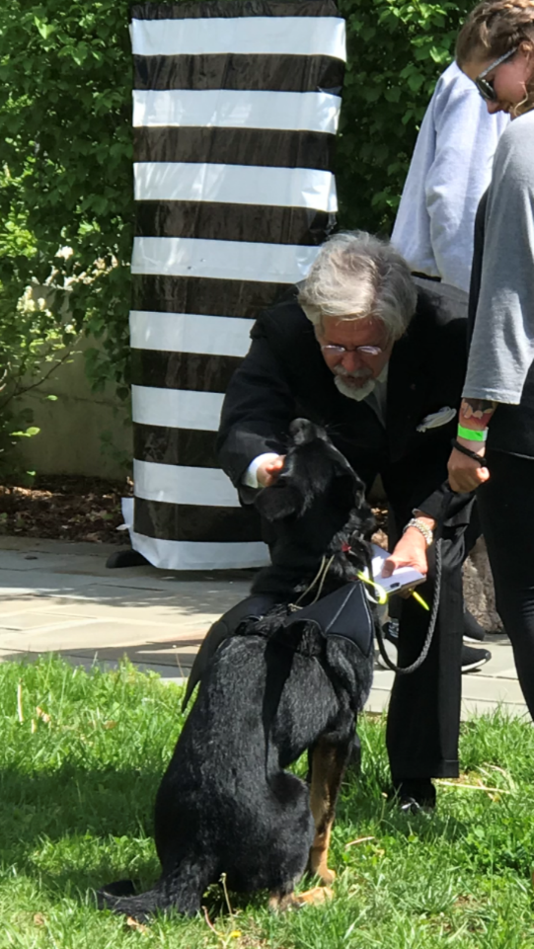
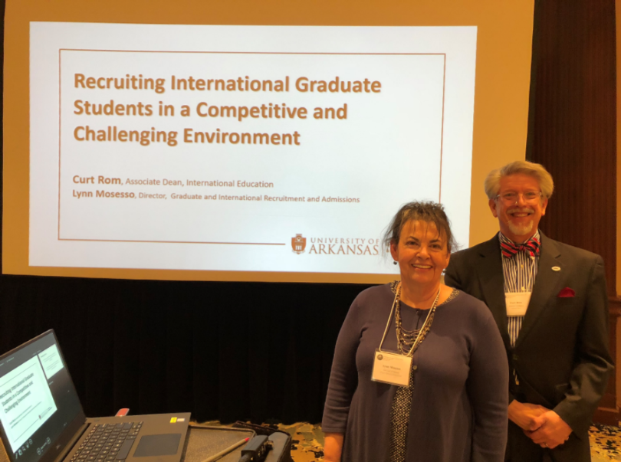
Thank you for all you do!

